Slide 1
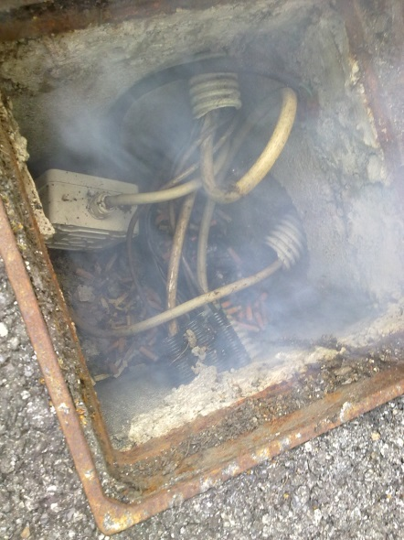
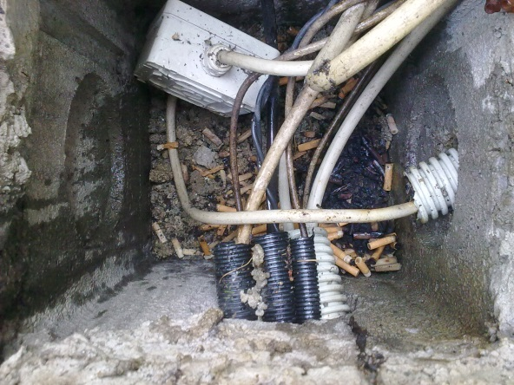

HS&E INCIDENT BULLETIN |  | January - September 2015
Location Country | Type of incident (example: Slip-Trip, Fall from Height, Vehicle , Laceration, Chemical Exposure)
Summary:
Fire starting and smoke coming from manhole (external area)
Root Causes: | Actions Taken Thus Far: Next Steps
Presence of butts into a manhole; Irresponsible behavior of smokers | Identify smoke areas; Monitoring compliance of smoke prohibition outside dedicated areas; Undertake disciplinary actions in case of failure to comply with the new internal directive

